Slide 1
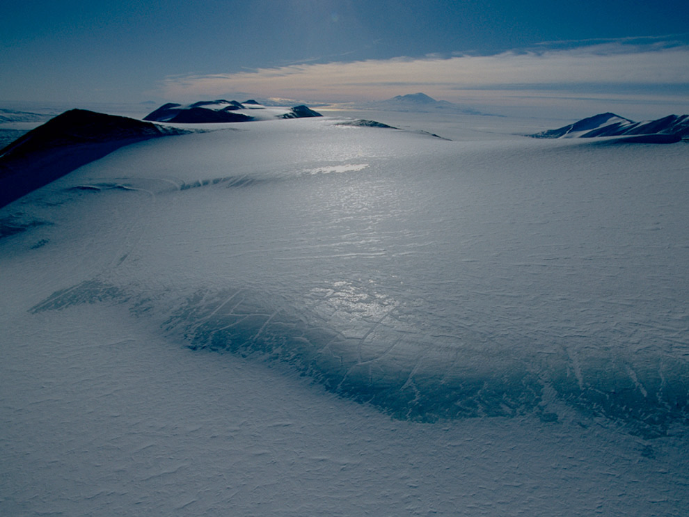
SURVIVAL IN THE FROZEN DESERT (THE CASE OF TERRESTRIAL ANTARCTIC ARTHROPODS)
GROUP 11

Slide 2
PRESENTATION OUTLINE
EXPLANATION OF KEY TERMS
CHARACTERISTICS OF THE FROZEN DESERT ECOSYSTEM
TERRESTRIAL ANTARCTIC ARTHROPODS
EXAMPLES
HOW DO THEY SURVIVE?
CONCLUSION
REFERENCES

Slide 3
EXPLANATION OF KEY TERMS
DESERTS: Deserts are arid ecosystems that receive fewer than 25 centimeters (10 inches) of precipitation a year.
COLD DESERT: Areas with less than 250mm of annual precipitation and average temperatures of less than 10°C in the warmest month.
ARTHROPODS: An arthropod is a type of creature that has many joints, a chitinous exoskeleton, divisions, and an open circulatory system.

Slide 4
CHARACTERISTICS OF THE FROZEN DESERT ECOSYSTEM
Very low temperatures
Very low amount of precipitation
High aridity
Little or no vegetation
Very windy
Large amount of snowfall
Short and moderately warm summers

Slide 5
TERRESTRIAL ANTARCTIC ARTHROPODS: EXAMPLES
Order Collembola
Order Diptera (Midges)
Order Acaris (Ticks and Mites)

Slide 6
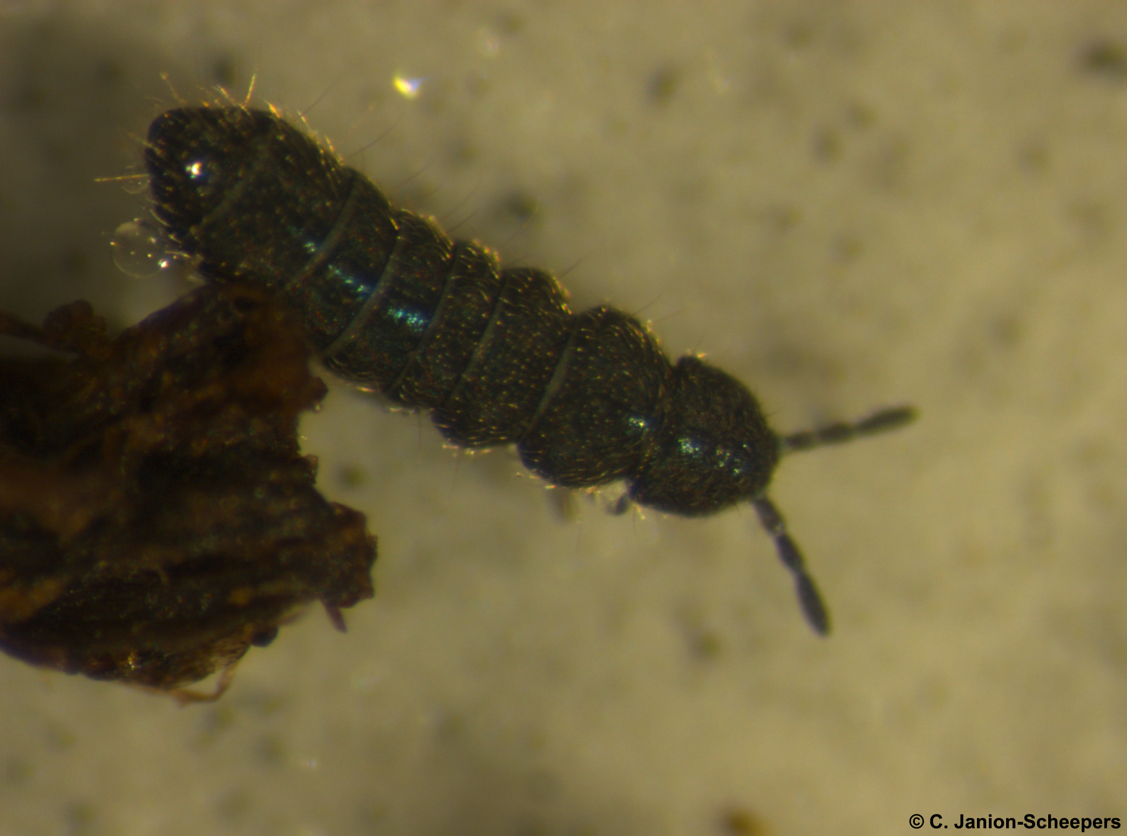
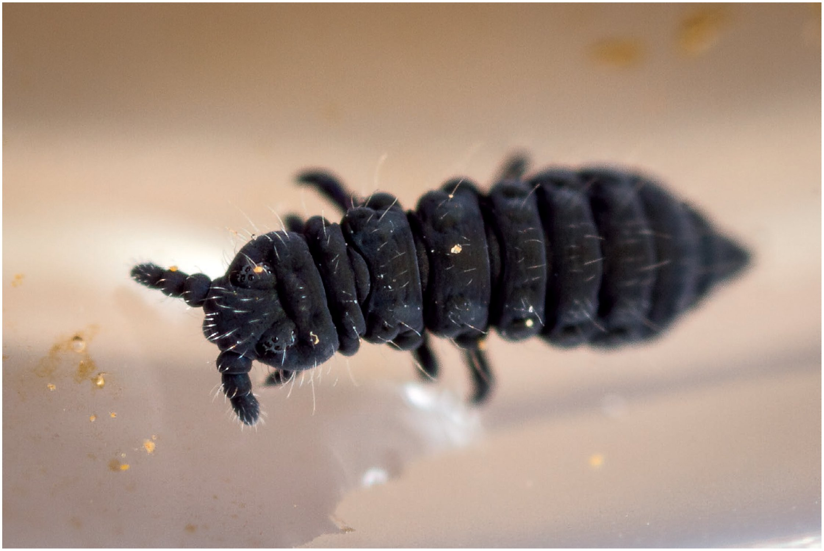
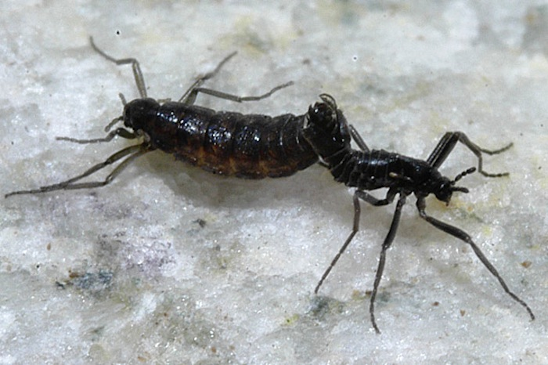
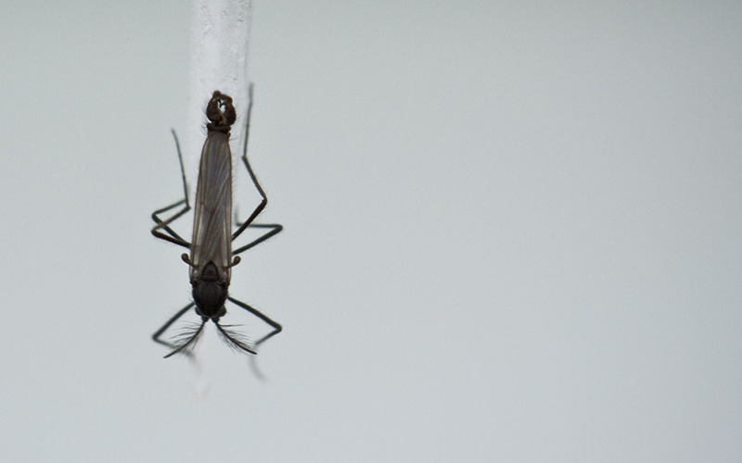
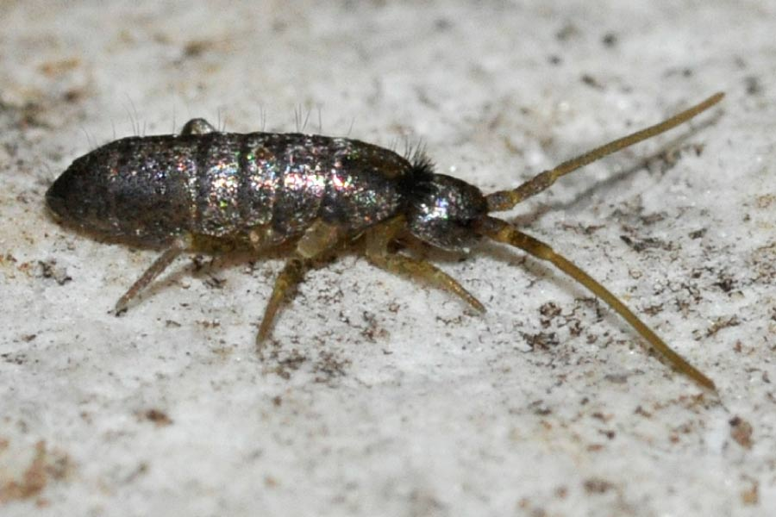
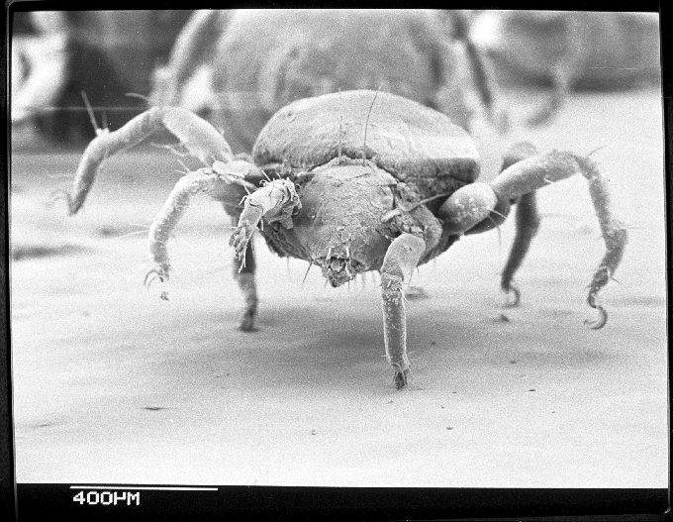
TERRESTRIAL ANTARCTIC ARTHROPODS: EXAMPLES
Cryptopygus antarcticus
Friesea grisea
Belgica antarctica
Parochlus steinenii
Eretmoptera murphyi
Alaskozetes antarticus

Slide 7
SURVIVAL OF TERRESTRIAL ANTARCTIC ARTHTROPODS: BEHAVIOURAL ADAPTATIONS
Life span extensions
Freeze-avoiding

Slide 8
SURVIVAL OF TERRESTRIAL ANTARCTIC ARTHTROPODS: STRUCTURAL ADAPTATIONS
Brachyptery
Chitinous exoskeleton

Slide 9
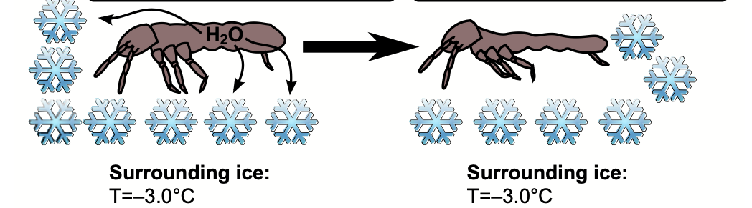
SURVIVAL OF TERRESTRIAL ANTARCTIC ARTHTROPODS: PHYSIOLOGICAL ADAPTATIONS
Supercooling mechanism
Cryoprotective dehydration
Antifreeze proteins
Near-anhydrobiotic state
A B

Slide 10
CONCLUSION
The terrestrial Antarctic arthropods showcase the wonders of nature's resilience and adaptability. Their survival in such an extreme environment serves as a testament to the incredible diversity of life and the ongoing need to preserve and protect the unique biodiversity

Slide 11
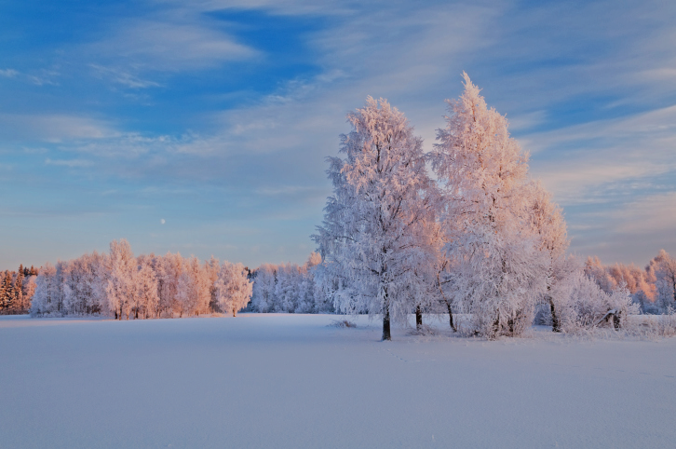
THANK YOU FOR YOUR AUDIENCE

Slide 12
REFERENCES
Benoit, J. B., Yoder, J. A., Lopez-Martinez, G., Elnitsky, M. A., Lee, R. E., Jr and Denlinger, D. L. (2008). Adaptations for the maintenance of water balance by three species of Antarctic mites. Polar Biol. 31, 539-547.
Convey, P. (2010). Life-history adaptations to polar and alpine environments. In Low Temperature Biology of Insects (ed. D. L. Denlinger and R. E. Lee, Jr), pp. 297-321. Cambridge: Cambridge University Press.
Convey, P. and Block, W. (1996). Antarctic Diptera: ecology, physiology and distribution. Eur. J. Entomol. 93, 1-13.
Sørensen, J. G., & Holmstrup, M. (2011). Cryoprotective dehydration is widespread in Arctic springtails. Journal of Insect Physiology, 57(8), 1147–1153. https://doi.org/10.1016/j.jinsphys.2011.03.001
Teets, N. M., & Denlinger, D. L. (2014). Surviving in a frozen desert: Environmental stress physiology of terrestrial Antarctic arthropods. In Journal of Experimental Biology (Vol. 217, Issue 1, pp. 84–93). Company of Biologists Ltd. https://doi.org/10.1242/jeb.089490
Worland, M. R. and Block, W. (1986). Survival and water-loss in some Antarctic arthropods. J. Insect Physiol. 32, 579-584.

